Slide 1


Privacy Network
A Privacy-Preserving Efficient Location-Sharing Scheme for Mobile Online Social Network Applications

Slide 2
Privacy Network
Supervisor :- Munmun Chakraborty
Group No. 16
Anumoy Nandy (00201100121)
Kunal Pramanick (302111001005)
Manas Pratim Biswas (002011001025)

Slide 3


Introduction

Slide 4
Location Sharing and Privacy
File sharing — Dropbox, Google Drive
Chats — Slack, Discord
Messaging — Facebook, WhatsApp
Payments — PayPal
Code — GitHub, GitLab, BitBucket

Slide 5
Why Privacy Network?
Ironical Reason
Shifting from centralized protocols (CVS, Subversion) running on multiple servers to decentralized protocols (DVCS, Git) running on a centralized GitHub server
https://mako.cc/writing/hill-free_tools.html

Slide 6
Stock Slide

Slide 7
Proof of Work

Slide 8
A Quick Demo

Slide 9
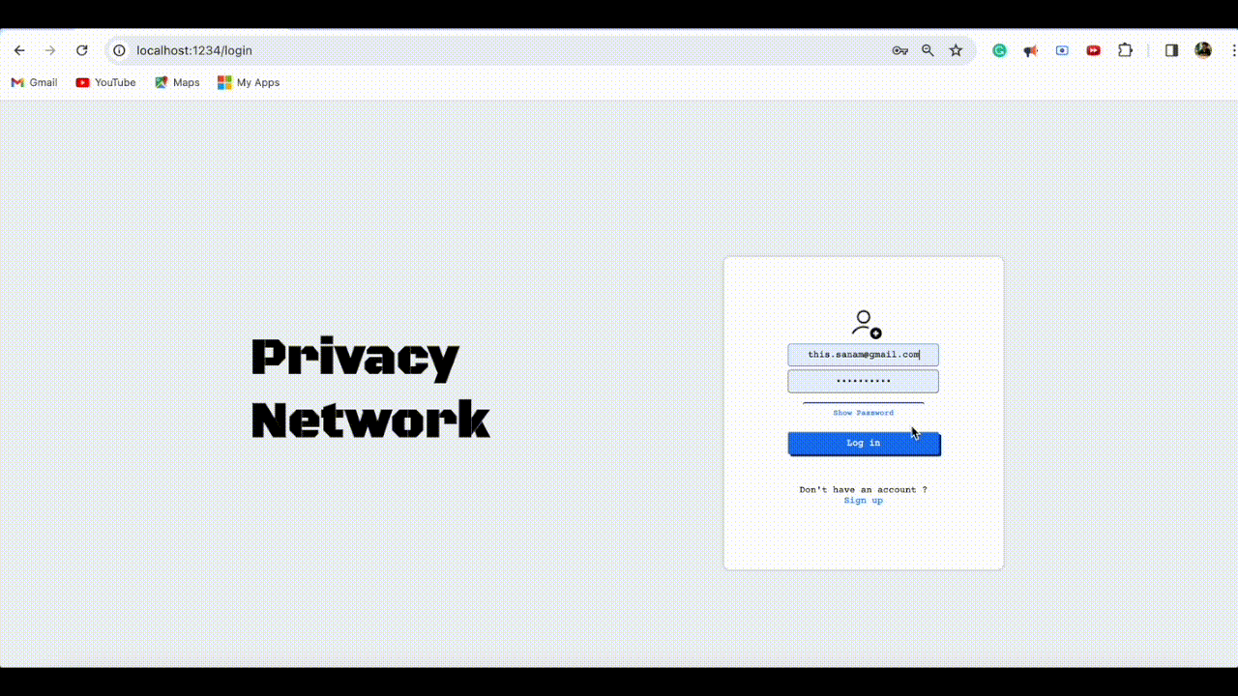

Slide 10










TechStack

Slide 11
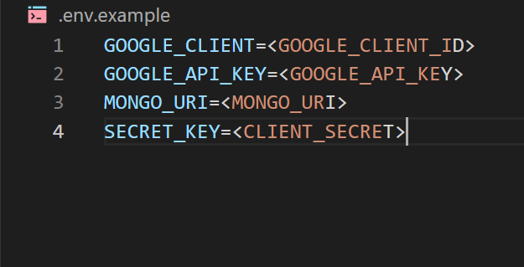
.env.example

Slide 12
Authentication

Slide 13
Authentication Metrics
- False acceptance rate.
- False rejection rate.
- Failure to enroll rate.
- Authentication time.

Slide 14
Authorization

Slide 15
Authorization Metrics
- Access control effectiveness.
- Least privilege enforcement.
- Policy violations.
- Audit trail quality.

Slide 16
Authentication & Authorization
Deep Dive
- bcrypt.js package for password hashing.
- jsonwebtoken to maintain session.
- middleware to authorize user before accessing some
component.
- @react-oauth/google package for authenticating
an users through their valid credentials.

Slide 17
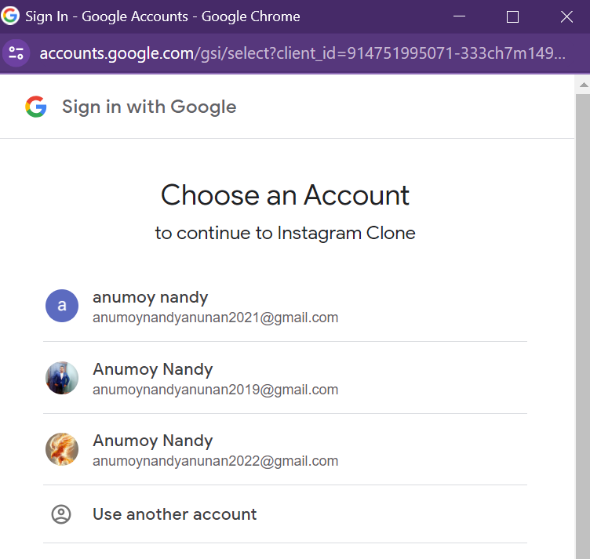
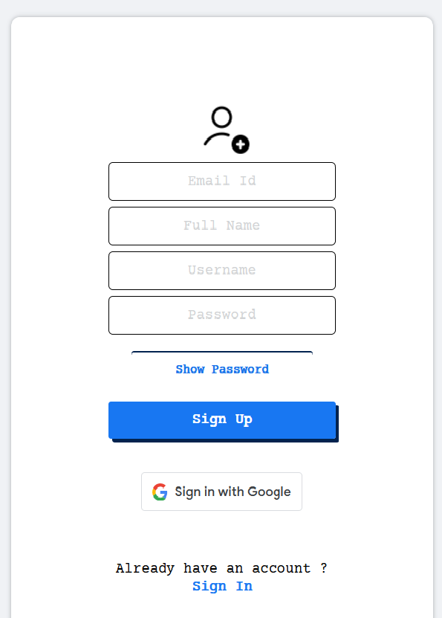
Authentication & Authorization
Deep Dive

Slide 18
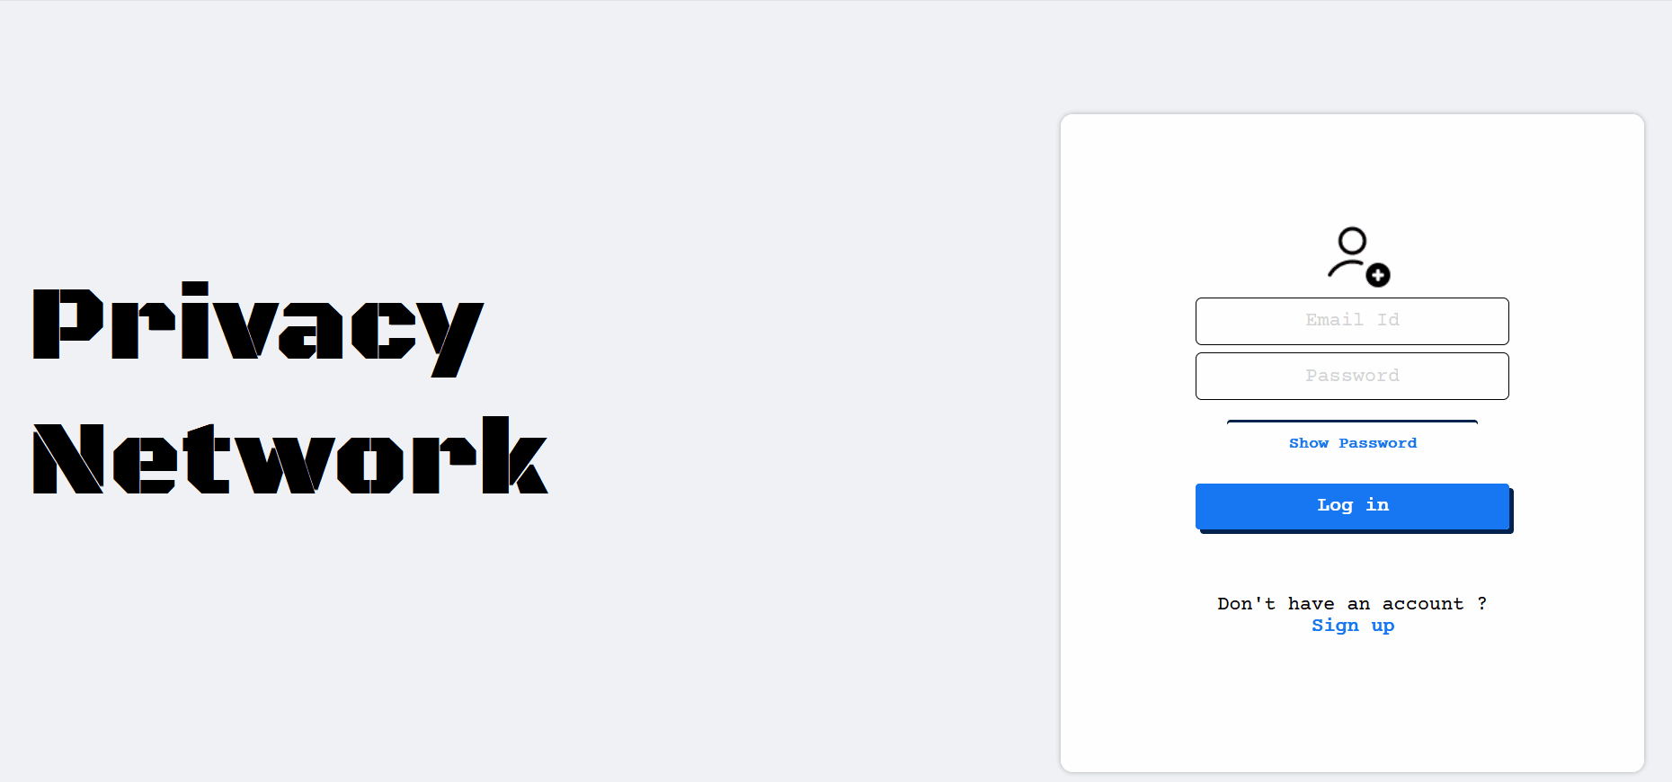
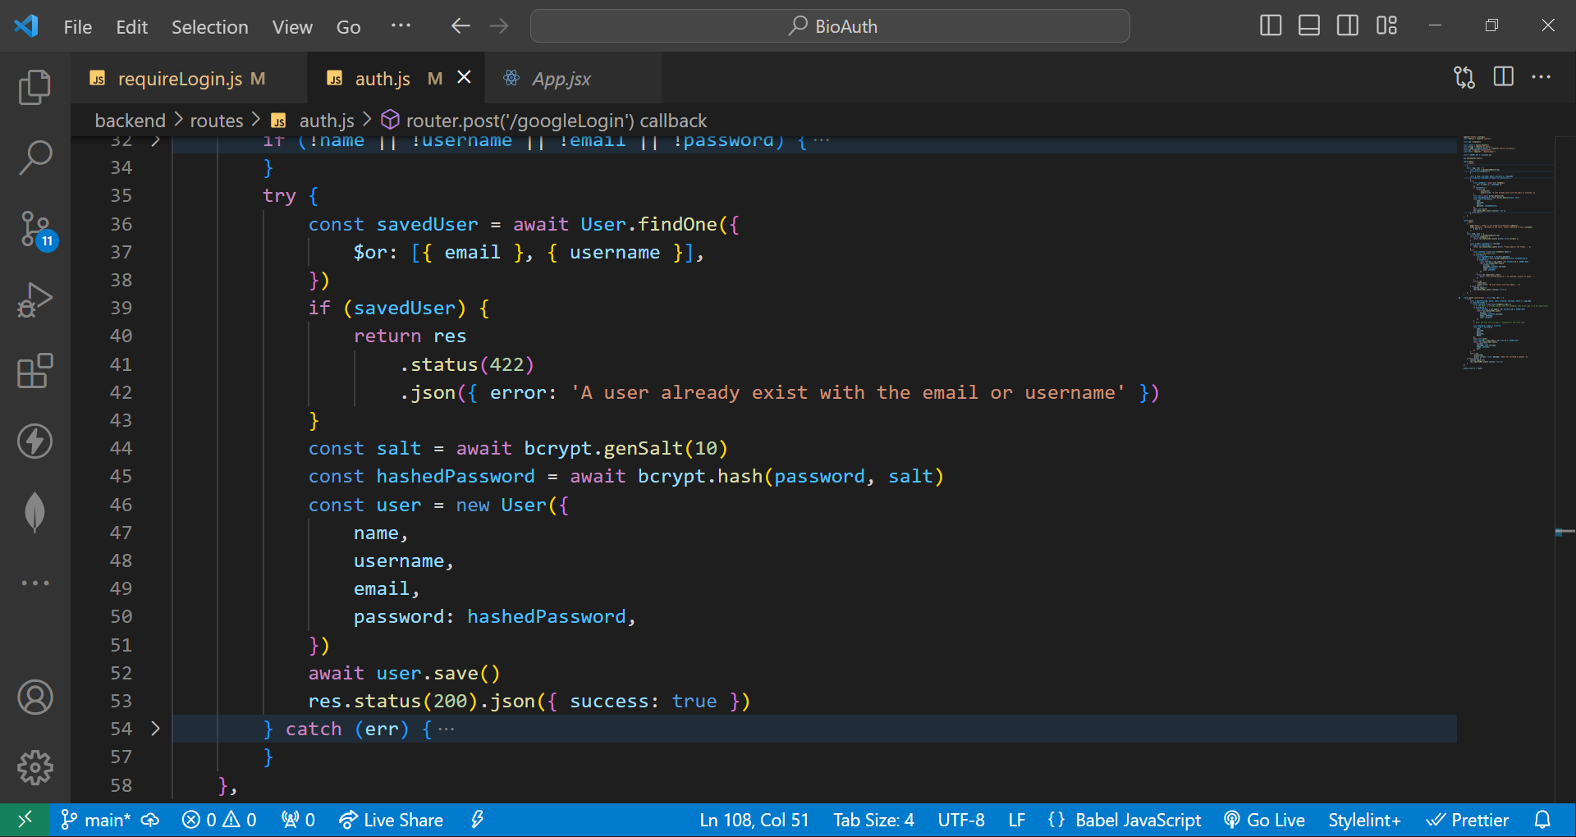

Slide 19
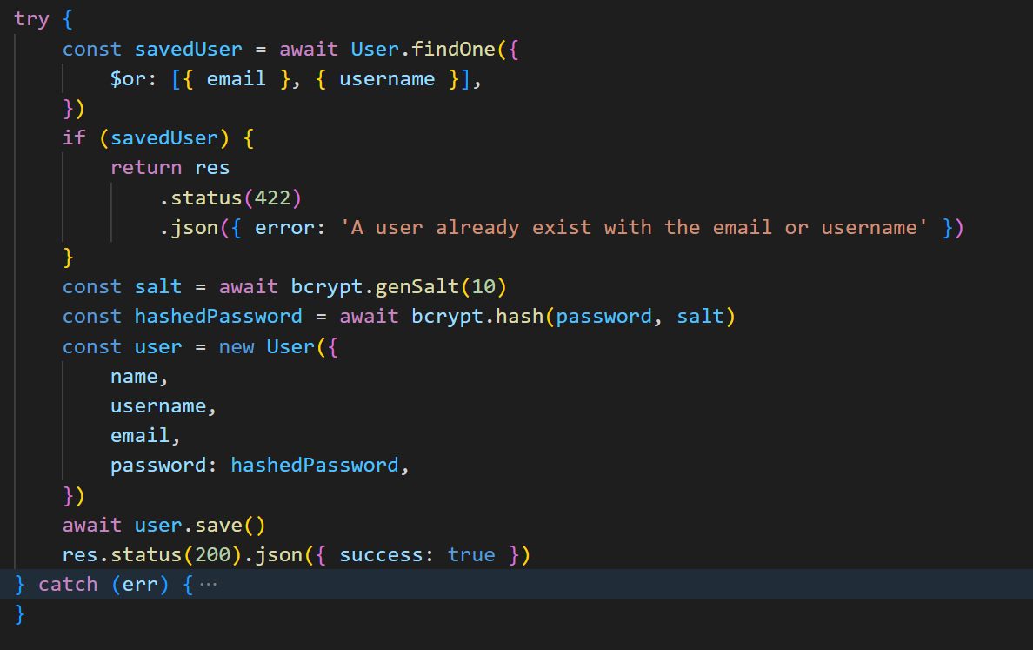
Authentication & Authorization
Deep Dive

Slide 20
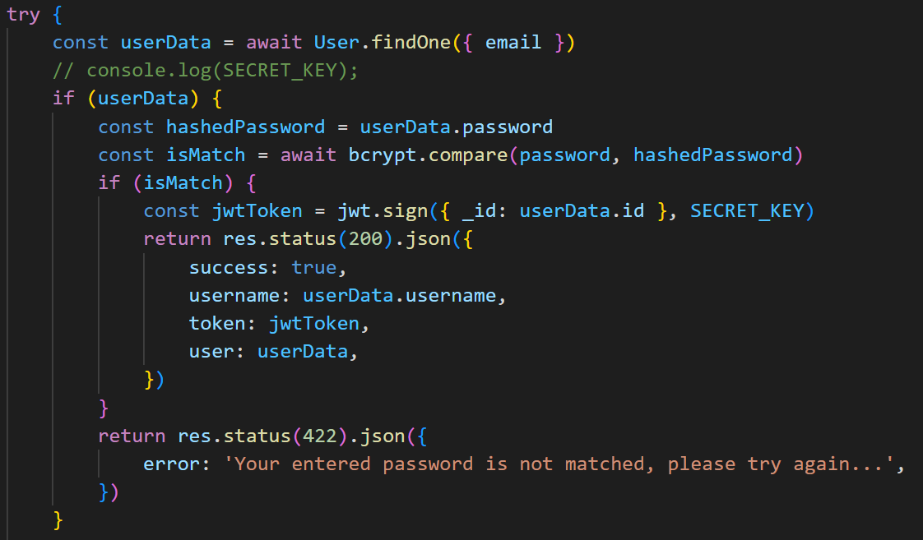
Authentication & Authorization
Deep Dive

Slide 21
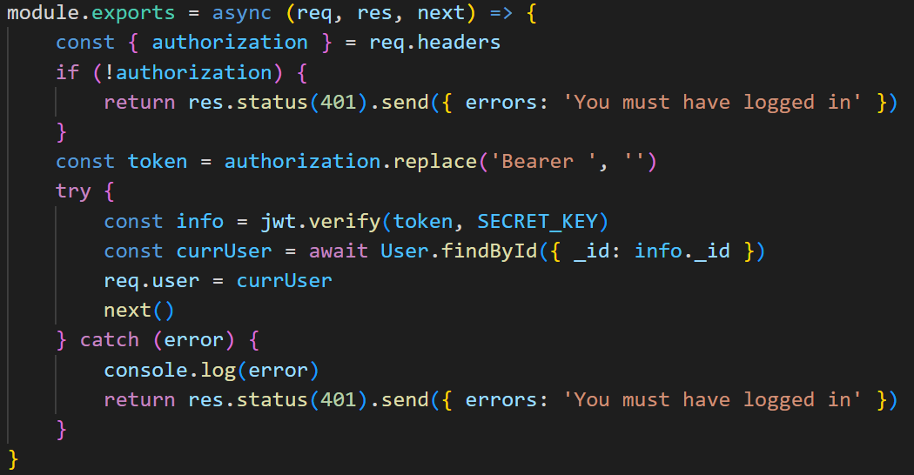
Authentication & Authorization
Deep Dive

Slide 22
Landing Page

Slide 23
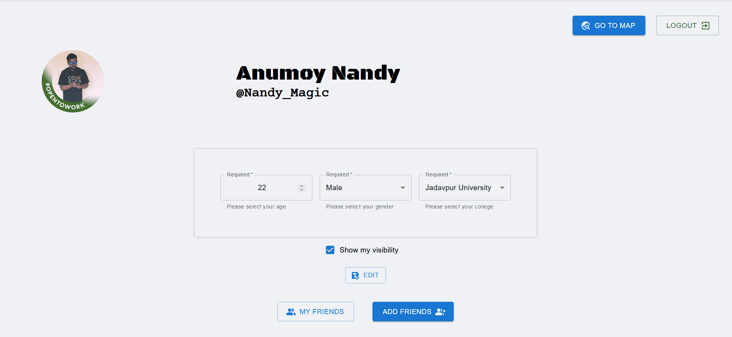

Slide 24
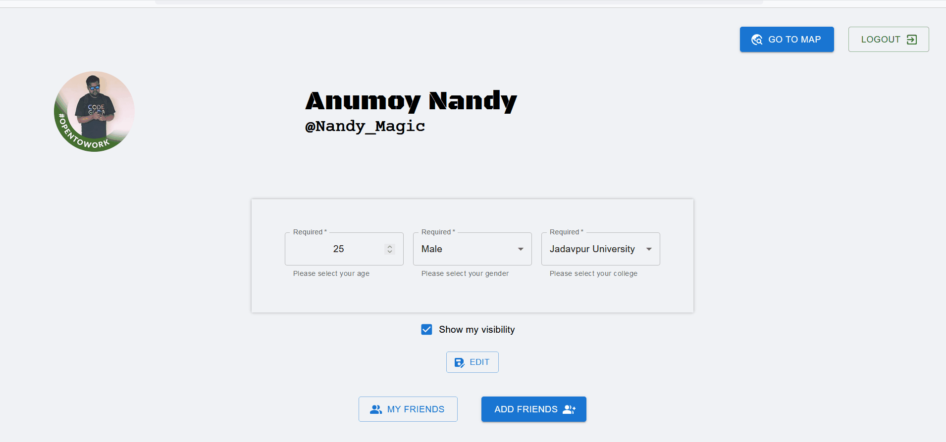

Slide 25
Location Page

Slide 26


Slide 27
Euclidean Distance

Slide 28
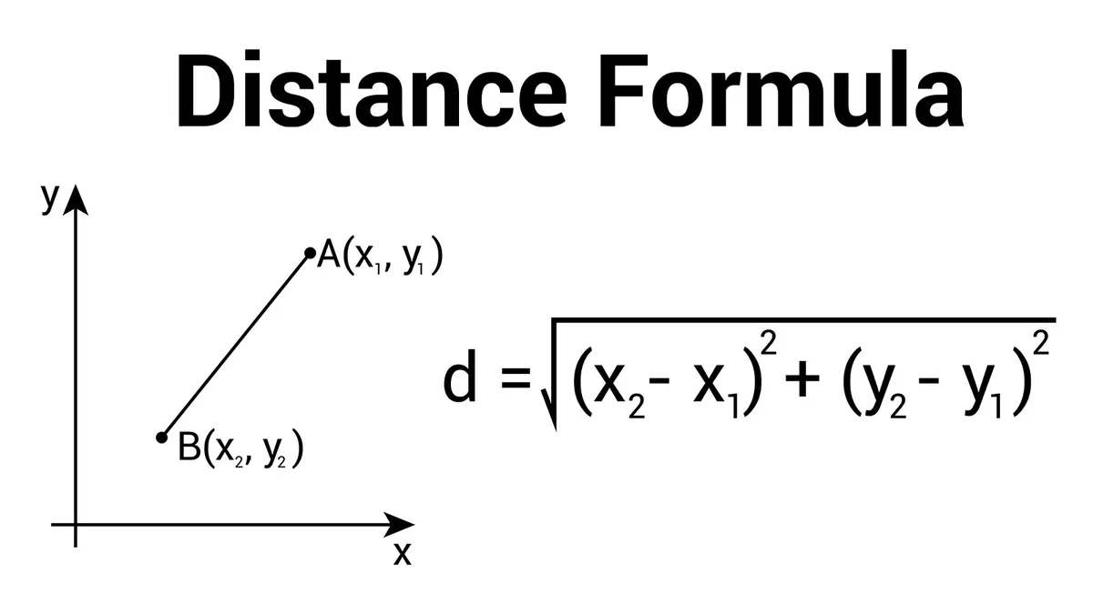

Slide 29
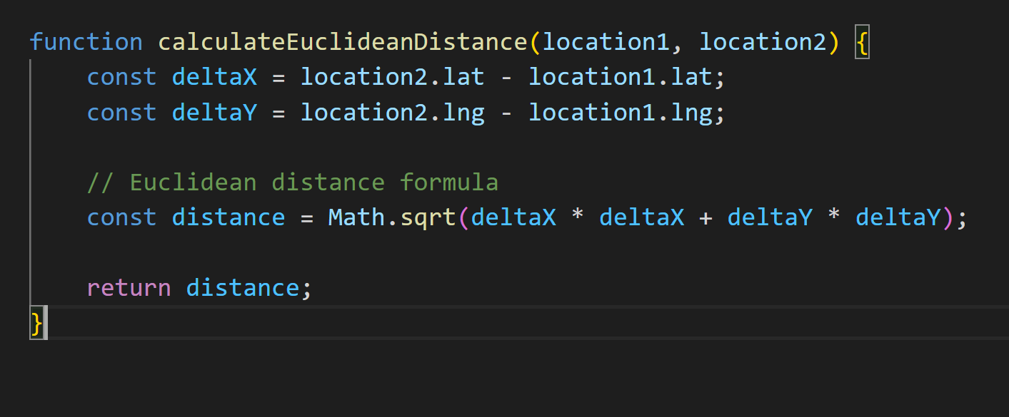

Slide 30
PostgreSQL
with
PostGIS

Slide 31
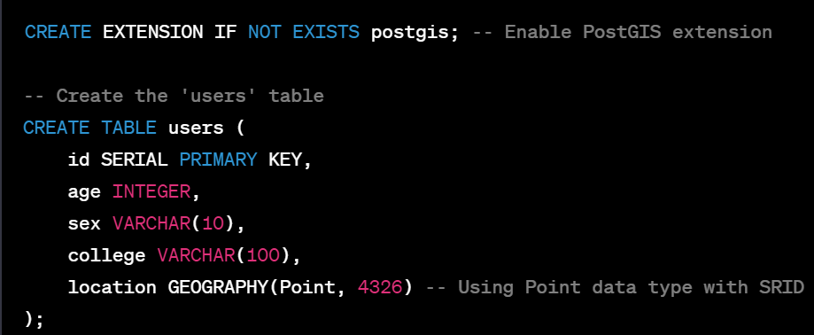

Slide 32
PostGIS Query

Slide 33
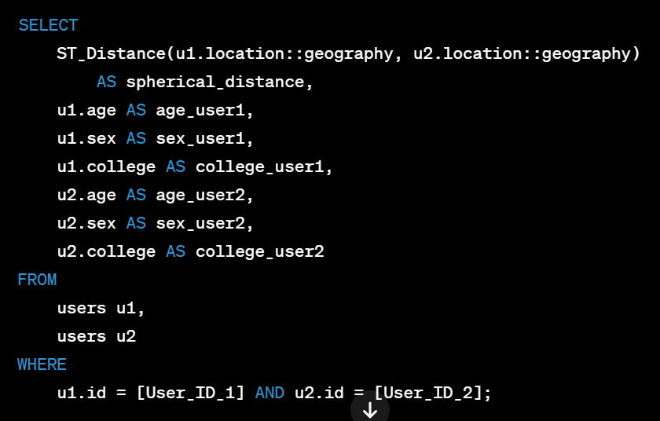

Slide 34
Conclusions

Slide 35
References
https://blog.printf.net/articles/2015/05/29/announcing-gittorrent-a-decentralized-github/
https://github.com/cjb/GitTorrent
https://lwn.net/Articles/646628/
https://news.ycombinator.com/item?id=9625840

Slide 36
Thank you
https://github.com/sanam2405/PrivacyNetwork
Anumoy Nandy
Kunal Pramanick
Manas Pratim Biswas
Dept. of Information Technology
Jadavpur University

Slide 37
Questions ?

